Slide 1

In-Class Quiz
授課教師：陳亘佑

Slide 2
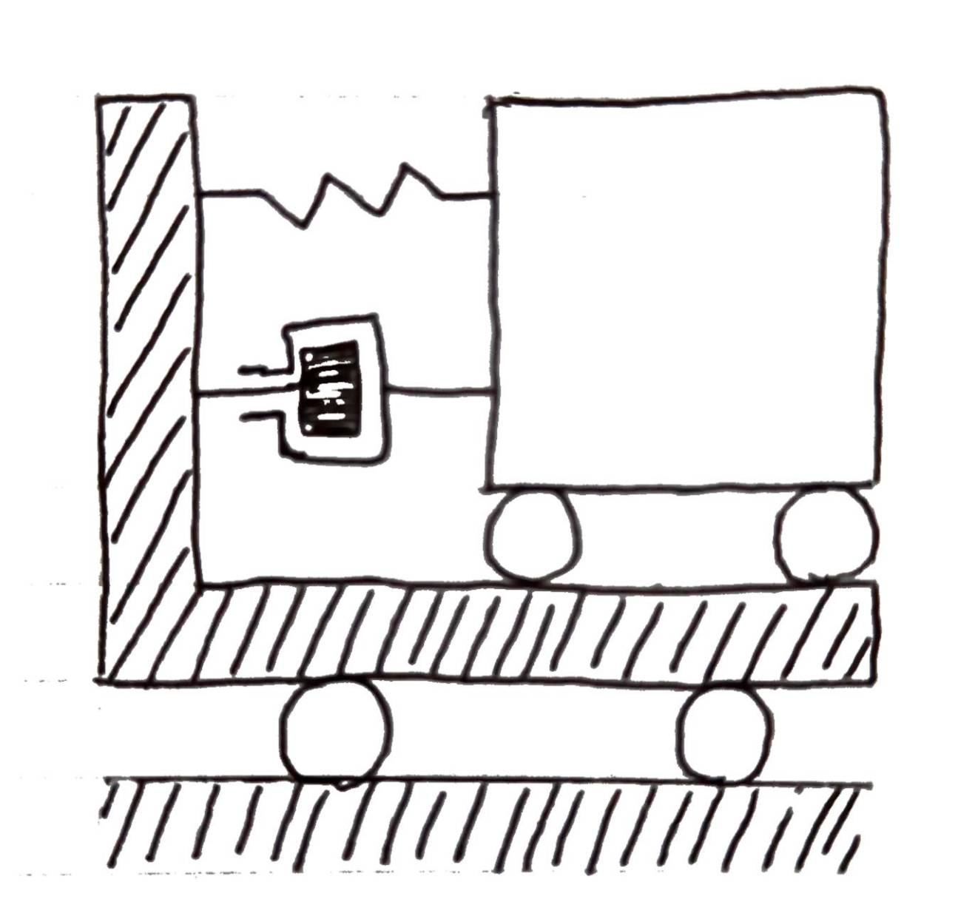




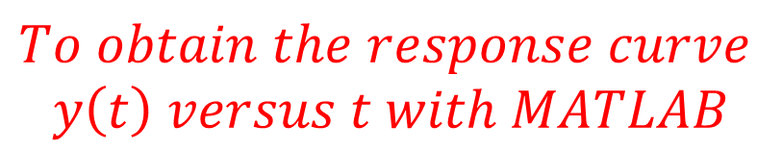

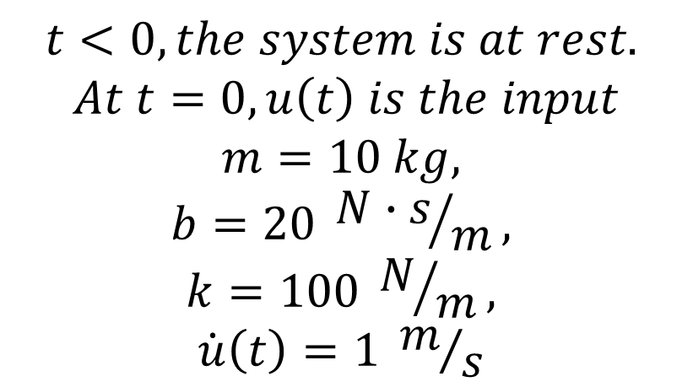
Mechanical Dynamic System Analysis
$$u$$
$$y$$
$$t<0, the system is at rest.$$
$$At t=0, u\left(t\right) is the input$$
$$m=10 kg,$$
$$b=20 {N∙s}/m,$$
$$k=100 N/m,$$
$$\dot{u}\left(t\right)=1 m/s$$
$$k$$
$$m$$
$$b$$
$$To obtain the response curve$$
$$y\left(t\right) versus t with MATLAB$$
Ref: Katsuhiko Qgata, “SYSTEM DYNAMICS”, Fourth Edition, pp.192-193

Slide 3
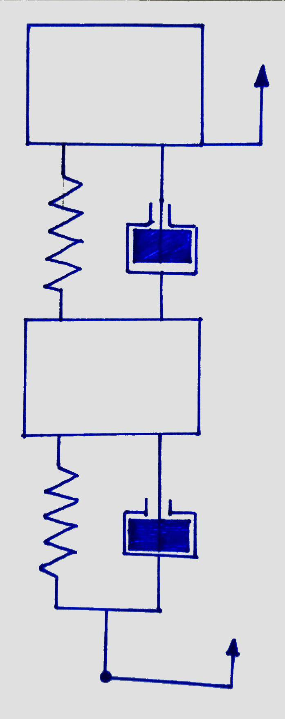

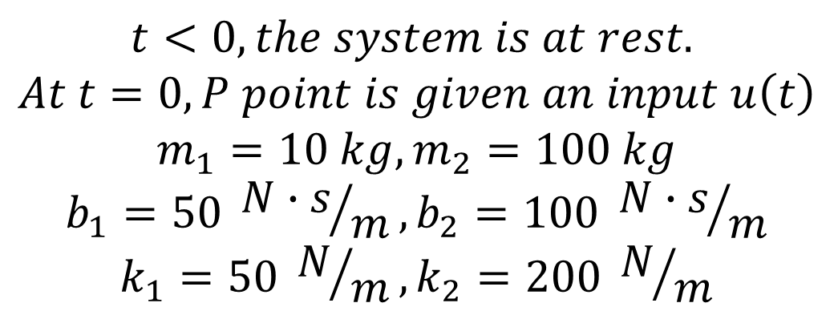









Mechanical Dynamic System Analysis
$$m_{2}$$
$$y$$
$$t<0, the system is at rest.$$
$$At t=0, P point is given an input u\left(t\right)$$
$$m_{1}=10 kg, m_{2}=100 kg$$
$$b_{1}=50 {N∙s}/m,b_{2}=100 {N∙s}/m$$
$$k_{1}=50 N/m,k_{2}=200 N/m$$
$$k_{2}$$
$$b_{2}$$
$$x$$
$$m_{1}$$
$$k_{1}$$
$$b_{1}$$
$$To obtain the State−Space Equation$$
$$u$$
Ref: Katsuhiko Qgata, “SYSTEM DYNAMICS”, Fourth Edition, pp.196-197
$$P$$

Slide 4
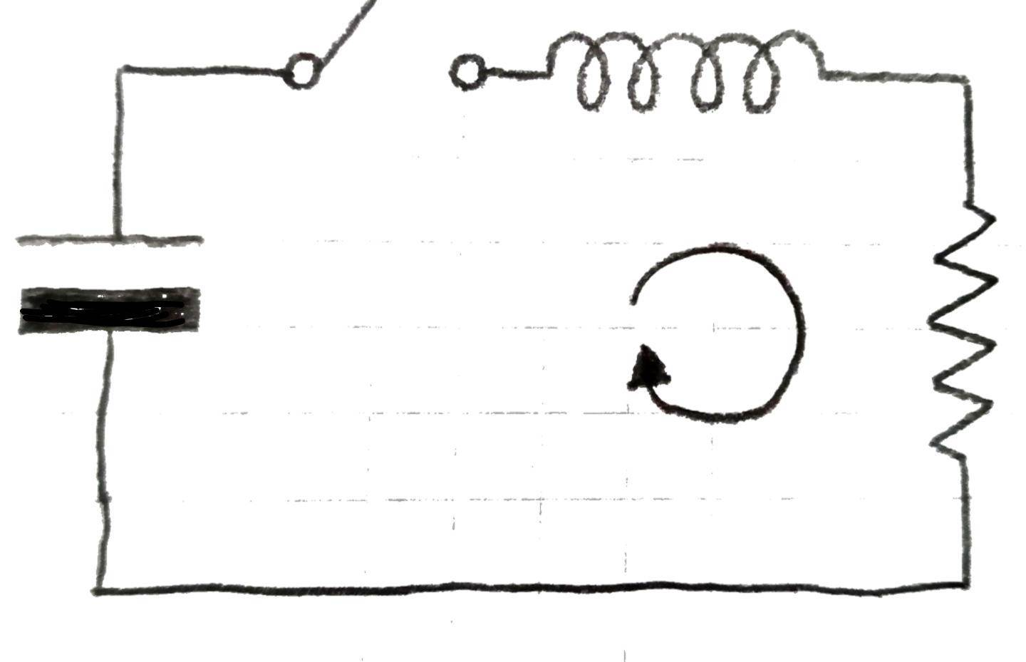





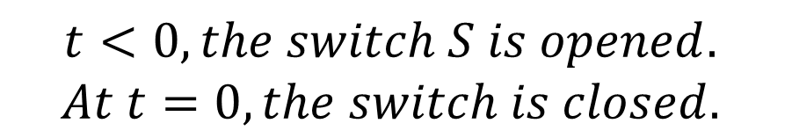
Mechanical Dynamic System Analysis
$$s$$
$$L$$
$$t<0, the switch S is opened.$$
$$At t=0, the switch is closed.$$
$$v$$
$$i$$
$$R$$
$$Please find the equation i\left(t\right)$$
Ref: Katsuhiko Qgata, “SYSTEM DYNAMICS”, Fourth Edition, pp.261-262

Slide 5
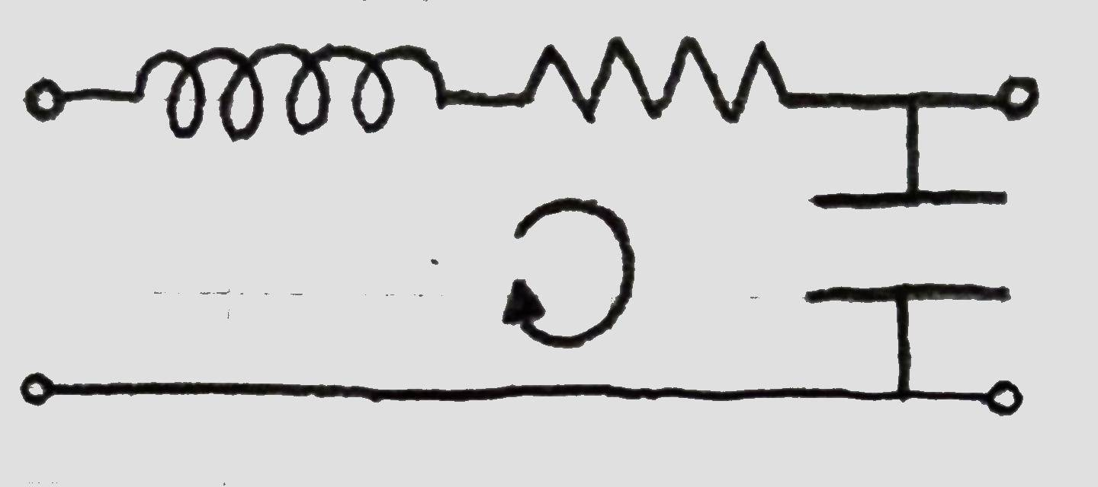






Mechanical Dynamic System Analysis
Ref: Katsuhiko Qgata, “SYSTEM DYNAMICS”, Fourth Edition, pp.264-265
$$R$$
$$L$$
$$v_{i}$$
$$i$$
$$C$$
$$v_{o}$$
$$To obtain the State−Space Equation$$

